Slide 1
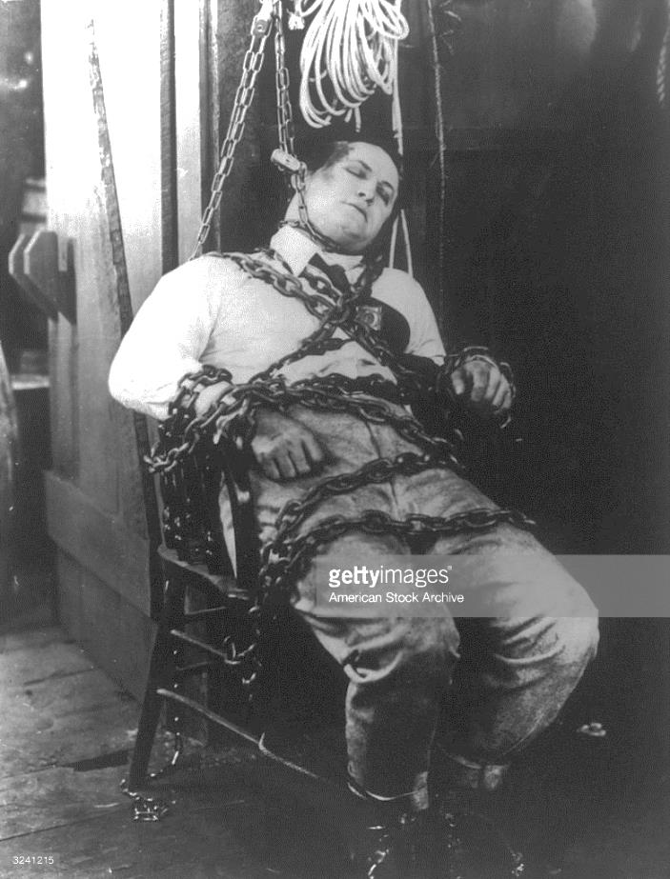
Constraint Programming (CP): Fun and Power
Lunch Tech Talk; 30th Jan 2018
Andrew Davison, CoE, PSU Hat Yai Campus
E-mail: ad@fivedots.coe.psu.ac.th

Slide 2
1. What is CP used for?
In industry:
scheduling and resource allocation
staff rostering
complex configuration problems
DNA sequencing
vehicle routing
analysis of analog circuits
...
In general: combinatorial problems
the combination of objects belonging to a finite set in accordance with certain constraints

Slide 3
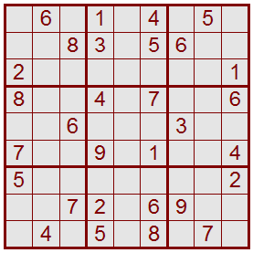
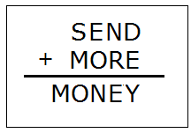
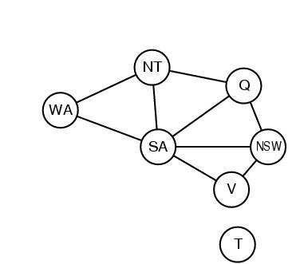
My Interests in CP
1 2 3 4 5 6 7 8 9
A
B
C
D
E
F
G
H
I
Modelling grid/pencil games:
e.g. sudoku
Recreational math/CS puzzles:
e.g. cryptarithmetic problems
Experimenting with math/CS concepts:
e.g. graph related

Slide 4
2. Model a Problem in CP
A finite set of variables: X1, X2, …, Xn
A domain (set) of values for each variable:
D1, D2, …, Dn
A finite set of constraints: C1, C2, …, Cm
each constraint Ci limits the values that the variables can take, e.g., X1 ≠ X2

Slide 5
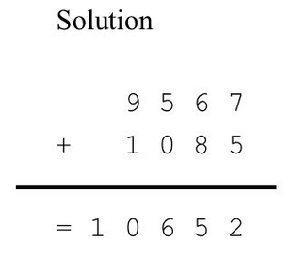
Cryptarithmetic
Find the digits corresponding to the letters:

Slide 6
Modeling
Variables={S,E,N,D,M,O,R,Y}
Domain={0,1,2,3,4,5,6,7,8,9}
Constraints
The variables are all different
S != 0, M != 0
S*10³+E*10²+N*10+D {SEND}
+ M*10³+O*10²+R*10+E {MORE} = M*10⁴+O*10³+N*10²+E*10+Y {MONEY}

Slide 7
Coding Cryptarithmetic
var 1..9: S; var 0..9: E;
var 0..9: N; var 0..9: D;
var 1..9: M; var 0..9: O;
var 0..9: R; var 0..9: Y;
constraint 1000 * S + 100 * E + 10 * N + D
+ 1000 * M + 100 * O + 10 * R + E
= 10000 * M + 1000 * O + 100 * N + 10 * E + Y;
constraint alldifferent([S,E,N,D,M,O,R,Y]);
written in MiniZinc
(http://www.minizinc.org/)

Slide 8
3. CP Execution
Create a model
Propogate the constraints
reduce the possible values for the variables
(Backtracking) search
Choose a variable; 'guess' a value; create a branch node; investigate the branches

Slide 9
Executing
alldifferent(S,E,N,D,
M,O,R,Y)
1000*S + 100*E + 10*N + D
+ 1000*M + 100*O + 10*R + E
= 10000*M + 1000*O + 100*N + 10*E + Y
S ∈ {1..9}
E ∈ {0..9}
N ∈ {0..9}
D ∈ {0..9}
M ∈ {1..9}
O ∈ {0..9}
R ∈ {0..9}
Y ∈ {0..9}

Slide 10
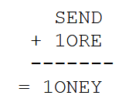
alldifferent(S,E,N,D,
M,O,R,Y)
1000*S + 100*E + 10*N + D
+ 1000*M + 100*O + 10*R + E
= 10000*M + 1000*O + 100*N + 10*E + Y
S ∈ {1..9}
E ∈ {0..9}
N ∈ {0..9}
D ∈ {0..9}
M ∈ {1}
O ∈ {0..9}
R ∈ {0..9}
Y ∈ {0..9}
M at the beginning of money is a carry from the thousands place, so M = 1.

Slide 11
alldifferent(S,E,N,D,
M,O,R,Y)
1000*S + 100*E + 10*N + D
+ 1000*M + 100*O + 10*R + E
= 10000*M + 1000*O + 100*N + 10*E + Y
S ∈ {2..9}
E ∈ {0,2..9}
N ∈ {0,2..9}
D ∈ {0,2..9}
M ∈ {1}
O ∈ {0,2..9}
R ∈ {0,2..9}
Y ∈ {0,2..9}

Slide 12
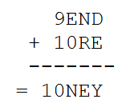
alldifferent(S,E,N,D,
M,O,R,Y)
1000*S + 100*E + 10*N + D
+ 1000*M + 100*O + 10*R + E
= 10000*M + 1000*O + 100*N + 10*E + Y
S ∈ {9}
E ∈ {0,2..9}
N ∈ {0,2..9}
D ∈ {0,2..9}
M ∈ {1}
O ∈ {0}
R ∈ {0,2..9}
Y ∈ {0,2..9}
In the thousands place there is a 1, so the only value for S that could cause a carry is S = 9 and that means O = 0.
and so on...

Slide 13
Branch
S ∈ {9}
E ∈ {4..7}
N ∈ {5..8}
D ∈ {2..8}
M ∈ {1}
O ∈ {0}
R ∈ {2..8}
Y ∈ {2..8}
E = 4
E ≠ 4
S ∈ {9}
E ∈ {4}
N ∈ {5..8}
D ∈ {2..8}
M ∈ {1}
O ∈ {0}
R ∈ {2..8}
Y ∈ {2..8}
S ∈ {9}
E ∈ {5..7}
N ∈ {5..8}
D ∈ {2..8}
M ∈ {1}
O ∈ {0}
R ∈ {2..8}
Y ∈ {2..8}

Slide 14
Propagate
S ∈ {9}
E ∈ {4..7}
N ∈ {5..8}
D ∈ {2..8}
M ∈ {1}
O ∈ {0}
R ∈ {2..8}
Y ∈ {2..8}
E = 4
E ≠ 4
S ∈ {9}
E ∈ {5..7}
N ∈ {6..8}
D ∈ {2..8}
M ∈ {1}
O ∈ {0}
R ∈ {2..8}
Y ∈ {2..8}

Slide 15
Branch
S ∈ {9}
E ∈ {4..7}
N ∈ {5..8}
D ∈ {2..8}
M ∈ {1}
O ∈ {0}
R ∈ {2..8}
Y ∈ {2..8}
E = 4
E ≠ 4
S ∈ {9}
E ∈ {5..7}
N ∈ {6..8}
D ∈ {2..8}
M ∈ {1}
O ∈ {0}
R ∈ {2..8}
Y ∈ {2..8}
E = 5
E ≠ 5
S ∈ {9}
E ∈ {5}
N ∈ {6..8}
D ∈ {2..8}
M ∈ {1}
O ∈ {0}
R ∈ {2..8}
Y ∈ {2..8}
S ∈ {9}
E ∈ {6..7}
N ∈ {6..8}
D ∈ {2..8}
M ∈ {1}
O ∈ {0}
R ∈ {2..8}
Y ∈ {2..8}

Slide 16
Propagate
S ∈ {9}
E ∈ {4..7}
N ∈ {5..8}
D ∈ {2..8}
M ∈ {1}
O ∈ {0}
R ∈ {2..8}
Y ∈ {2..8}
E = 4
E ≠ 4
S ∈ {9}
E ∈ {5..7}
N ∈ {6..8}
D ∈ {2..8}
M ∈ {1}
O ∈ {0}
R ∈ {2..8}
Y ∈ {2..8}
E = 5
E ≠ 5
S ∈ {9}
E ∈ {5}
N ∈ {6}
D ∈ {7}
M ∈ {1}
O ∈ {0}
R ∈ {8}
Y ∈ {2}
S ∈ {9}
E ∈ {6..7}
N ∈ {7..8}
D ∈ {2..8}
M ∈ {1}
O ∈ {0}
R ∈ {2..8}
Y ∈ {2..8}

Slide 17
Complete
Search
Tree
S ∈ {9}
E ∈ {4..7}
N ∈ {5..8}
D ∈ {2..8}
M ∈ {1}
O ∈ {0}
R ∈ {2..8}
Y ∈ {2..8}
E = 4
E ≠ 4
S ∈ {9}
E ∈ {5..7}
N ∈ {6..8}
D ∈ {2..8}
M ∈ {1}
O ∈ {0}
R ∈ {2..8}
Y ∈ {2..8}
E = 5
E ≠ 5
S ∈ {9}
E ∈ {5}
N ∈ {6}
D ∈ {7}
M ∈ {1}
O ∈ {0}
R ∈ {8}
Y ∈ {2}
S ∈ {9}
E ∈ {6..7}
N ∈ {7..8}
D ∈ {2..8}
M ∈ {1}
O ∈ {0}
R ∈ {2..8}
Y ∈ {2..8}
E = 6
E ≠ 6

Slide 18
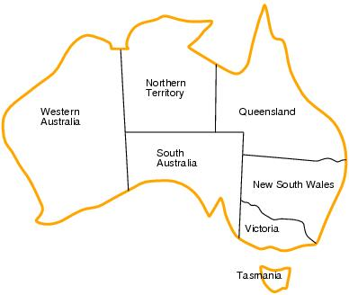
4. Map Coloring
Variables: WA, NT, Q, NSW, V, SA, T
Domains: D_{i} = {red,green,blue}
Constraints: adjacent regions must have different colours
E.g. WA ≠ NT

Slide 19
Coding in MiniZinc
% use integer to represent the colours
int: nc = 3; % number of colours
var 1..nc: wa; var 1..nc: nt; var 1..nc: sa;
var 1..nc: q; var 1..nc: nsw;
var 1..nc: v; var 1..nc: t;
constraint wa != nt;
constraint wa != sa;
constraint nt != sa;
constraint nt != q;
constraint sa != q;
constraint sa != nsw;
constraint sa != v;
constraint q != nsw;
constraint nsw != v;

Slide 20
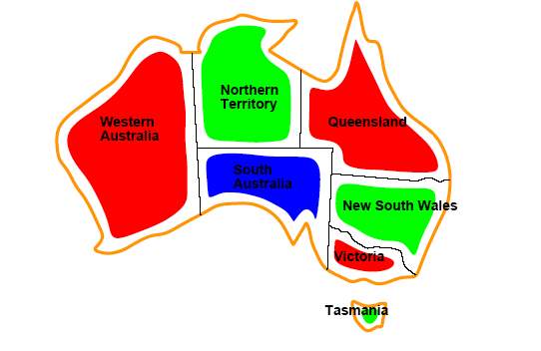
{ WA=red, NT=green,Q=red, NSW=green, V=red, SA=blue,T=green }

Slide 21
Constraint Graphs
Nodes are variables
Arcs are binary constraints
The graph can be used to simplify the search
e.g. Tasmania is an independent subproblem

Slide 22
5. Sudoku
1 2 3 4 5 6 7 8 9
A
B
C
D
E
F
G
H
I
Variables: 81 variables
A1, A2, A3, …, I7, I8, I9
Domains: The nine positive ints
A1 ∈ {1, 2, 3, 4, 5, 6, 7, 8, 9}
etc.
Constraints: 27 alldifferent constraints
alldifferent(A1, A2, A3, A4, A5, A6, A7, A8, A9)
etc.

Slide 23
Coding in MiniZinc
int: S = 3; // size of subsquare (width, height)
int: N = S * S; // size of grid (and no. of values)
array[1..N,1..N] of var 1..N: puzzle;
% All cells in a row, a column, and subsquare are different constraint
forall(i in 1..N)( alldifferent(j in 1..N)( puzzle[i,j] )) /\
forall(j in 1..N)( alldifferent(i in 1..N)( puzzle[i,j] )) /\
forall(i,j in 1..S)
( alldifferent(p,q in 1..S)( puzzle[S*(i-1)+p, S*(j-1)+q] ));

Slide 24
6. Transportation Problem
How much should be shipped from the sources to the destinations?
Demand Qty
Supplies
Source
Qty Shipped
Destination
a
1
x
1
b
1
11
1
x
x
1n
12
x
a
2
21
x
2
b
2
22
2
x
:
:
2n
:
:
a
m
n
b
m
n

Slide 25
Example
A1
200
A2
500
A3
B1
400
B2
B3
300
C1
C2
300
C3
400
D1
D2
100
D3
Find qty shipped?

Slide 26
Modeling
Variables: A1,A2,A3, B1,B2,B3, C1,C2,C3, D1,D2,D3
Domain: 0.0 .. Infinity
Constraints:
Demand constraints:
A1+A2+A3 = 200; B1+B2+B3 = 400; C1+C2+C3 = 300; D1+D2+D3 = 100
Capacity constraints:
A1+B1+C1+D1 ≤ 500; A2+B2+C2+D2 ≤ 300; A3+B3+C3+D3 ≤ 400
And minimize a cost constraint:
10*A1 + 7*A2 + 11*A3 + 8*B1 + 5*B2 + 10*B3 +
5*C1 + 5*C2 + 8*C3 + 9*D1 + 3*D2 + 7*D3
in MiniZinc use:
solve minimize

Slide 27
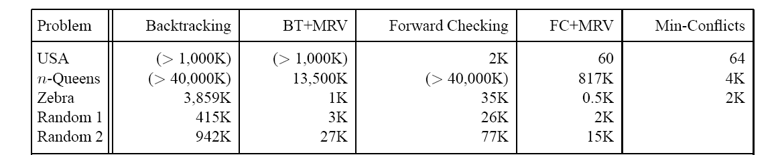
7. CP Search Techniques
Memory used; some don't finish

Slide 28
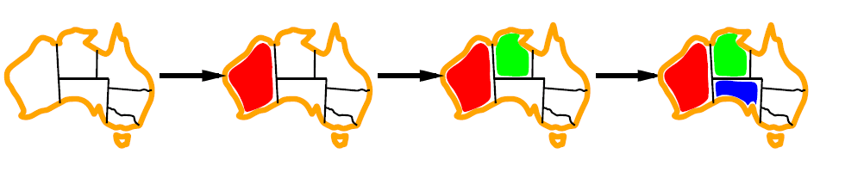
7.1. Minimum Remaining Values (MRV)
3 choices
2 choices
must be
blue
Choose the variable with the fewest possible values

Slide 29
7.2. Forward Checking
Keep track of the remaining possible values for all the unassigned variables.
Backtrack when any variable has no possible value.

Slide 30
4-Queens Problem
X1
{1,2,3,4}
X2
{1,2,3,4}
1
2
3
4
1
2
3
4
X3
{1,2,3,4}
X4
{1,2,3,4}

Slide 31
X1
{1,2,3,4}
X2
{1,2,3,4}
1
2
3
4
1
2
3
4
X3
{1,2,3,4}
X4
{1,2,3,4}

Slide 32
X1
{1,2,3,4}
X2
{ , ,3,4}
1
2
3
4
1
2
3
4
X3
{ ,2, ,4}
X4
{ ,2,3, }

Slide 33
X1
{1,2,3,4}
X2
{ , ,3,4}
1
2
3
4
1
2
3
4
X3
{ ,2, ,4}
X4
{ ,2,3, }

Slide 34
X1
{1,2,3,4}
X2
{ , ,3,4}
1
2
3
4
1
2
3
4
X3
{ , , , }
X4
{ , ,3, }
Time to backtrack.

Slide 35
X1
{1,2,3,4}
X2
{ , , ,4}
1
2
3
4
1
2
3
4
X3
{ ,2, ,4}
X4
{ ,2,3, }

Slide 36
X1
{1,2,3,4}
X2
{ , , ,4}
1
2
3
4
1
2
3
4
X3
{ ,2, ,4}
X4
{ ,2,3, }

Slide 37
X1
{1,2,3,4}
X2
{ , , ,4}
1
2
3
4
1
2
3
4
X3
{ ,2, , }
X4
{ , ,3, }

Slide 38
X1
{1,2,3,4}
X2
{ , , ,4}
1
2
3
4
1
2
3
4
X3
{ ,2, , }
X4
{ , ,3, }

Slide 39
X1
{1,2,3,4}
X2
{ , ,3,4}
1
2
3
4
1
2
3
4
X3
{ ,2, , }
X4
{ , , , }
Time to backtrack.

Slide 40
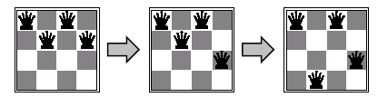
7.3. Min-Conflicts
hits=5
hits=3
hits=1
Select a value for a variable that results in the fewest conflicts with all the other variables.

Slide 41
8. The Future for CP
CP is becoming a standard technique for solving combinatorial problems, along with linear/integer programming.
Specific propagation, branching, and search algorithms will be developed for specific domains.

Slide 42
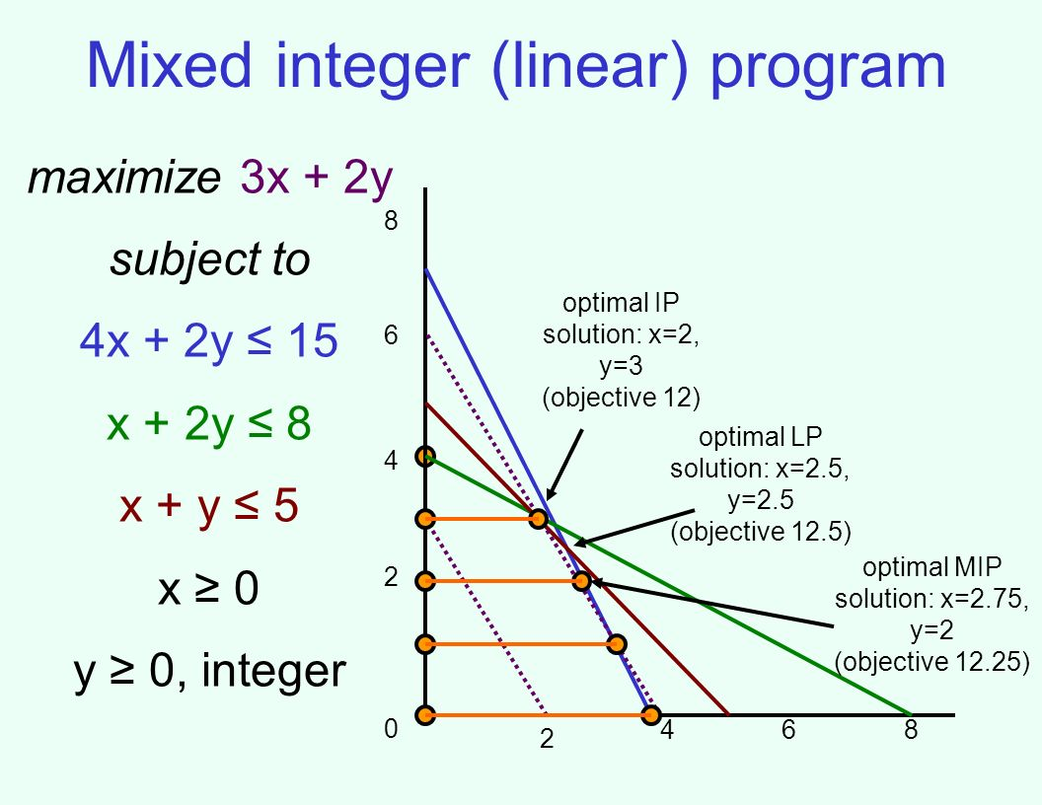

Slide 43
9. Some CP Systems
MiniZinc: language independent
CHIP: C++ and C (proprietary)
Choco: Java
ECLiPSe: Prolog
Gecode: C++, Python
Google or-tools: Python, Java, C++ and .NET
JaCoP: Java
SICStus Prolog

Slide 44
10. More Information
Chapter 6 of "Artificial Intelligence: A Modern Approach" (AIMA), Russell and Norvig, 3rd ed.
http://aima.cs.berkeley.edu/2nd-ed/newchap05.pdf
MiniZinc tutorial
http://www.minizinc.org/downloads/doc-latest/ minizinc-tute.pdf

